Slide 1
CST 205 OOP MODULE 4 MULTITHREADING -PART 3

Slide 2
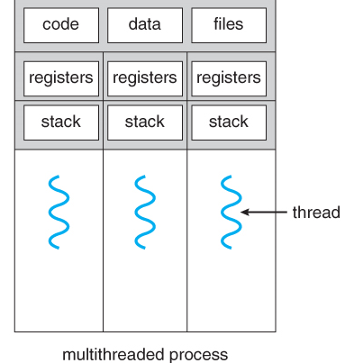
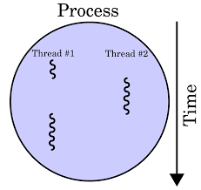
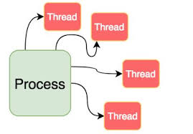
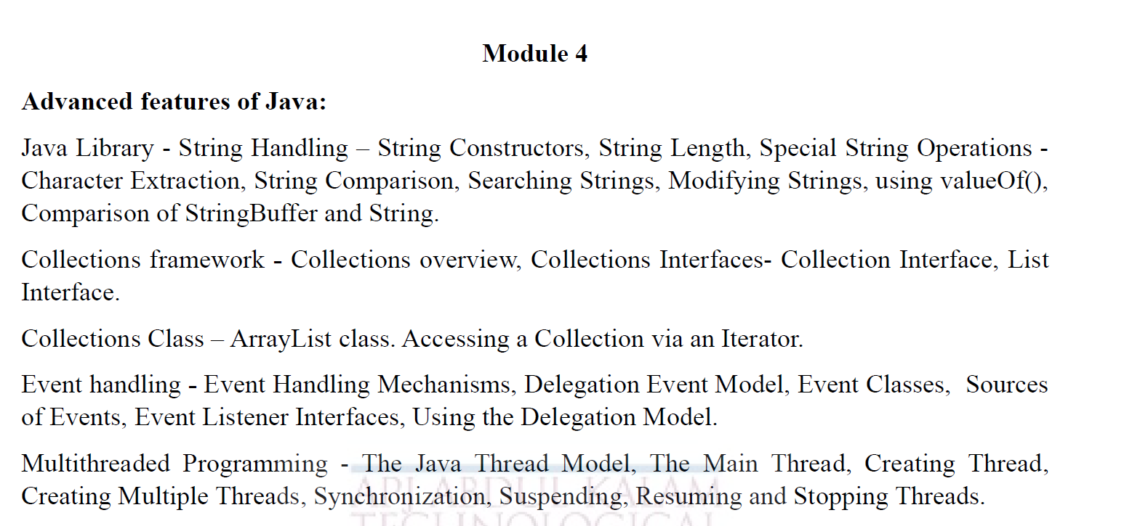

Slide 3
OBJECTIVE
To introduce thread priorities.
To examine thread synchronization.
Interthread communication

Slide 4
Thread Priorities
Used by the thread scheduler to decide when each thread should be allowed to run.
In theory, over a given period of time, higher-priority threads get more CPU time than lower-priority threads.
A higher-priority thread can also preempt a lower-priority one.
For instance, when a lower-priority thread is running and a higher-priority thread resumes (from sleeping or waiting on I/O,) it will preempt the lower-priority thread.

Slide 5
Thread Priorities
To set a thread’s priority, use the setPriority( ) method, which is a member of Thread.
This is its general form:
final void setPriority(int level)
Here, level specifies the new priority setting for the calling thread.
The value of level must be within the range MIN_PRIORITY and MAX_PRIORITY. Currently, these values are 1 and 10, respectively.
To return a thread to default priority, specify NORM_PRIORITY, which is currently 5.
These priorities are defined as static final variables within Thread.

Slide 6
Thread Priorities
If two threads have same priority then we can’t expect which thread will execute first. It depends on thread scheduler’s algorithm(Round-Robin, First Come First Serve, etc)
Thread with highest priority will get execution chance prior to other threads. Suppose there are 3 threads t1, t2 and t3 with priorities 4, 6 and 1. So, thread t2 will execute first based on maximum priority 6 after that t1 will execute and then t3.
Default priority for main thread is always 5, it can be changed later. Default priority for all other threads depends on the priority of parent thread.
A child thread gets same priority as parent .

Slide 7
Thread Priorities
You can obtain the current priority setting by calling the getPriority( ) method of Thread.
General form is shown here:
final int getPriority( )

Slide 8
Thread Priorities
class TestMultiPriority1 extends Thread{
public void run(){
System.out.println("running thread name is:"+Thread.currentThread().getName());
System.out.println("running thread priority is:"+Thread.currentThread().getPriority());
}
public static void main(String args[]){
TestMultiPriority1 m1=new TestMultiPriority1();
TestMultiPriority1 m2=new TestMultiPriority1();
m1.setPriority(Thread.MAX _PRIORITY);
m2.setPriority(Thread.MIN_PRIORITY);
m1.start();
m2.start();
} }

Slide 9
Thread Priorities
Output:
running thread name is:Thread-0
running thread priority is:10
running thread name is:Thread-1
running thread priority is:1

Slide 10
Synchronization in Java
Synchronization in java is the capability to control the access of multiple threads to any shared resource.
Java Synchronization is better option where we want to allow only one thread to access the shared resource.
Why use Synchronization
To prevent thread interference.
To prevent consistency problem.

Slide 11
Thread Synchronization
When two or more threads need access to a shared resource, they need some way to ensure that the resource will be used by only one thread at a time.
The process by which this is achieved is called synchronization.
Key to synchronization is the concept of the monitor(also called semaphore).
A monitor is an object that is used as a mutually exclusive lock (mutex).

Slide 12
Thread Synchronization
Concept of Lock in Java
Synchronization is built around an internal entity known as the lock or monitor.
Every object has an lock associated with it.
By convention, a thread that needs consistent access to an object's fields has to acquire the object's lock before accessing them, and then release the lock when it's done with them.

Slide 13
Thread Synchronization
Only one thread can own a monitor at a given time.
When a thread acquires a lock, it is said to have entered the monitor.
All other threads attempting to enter the locked monitor will be suspended until the first thread exits the monitor.
These other threads are said to be waiting for the monitor.

Slide 14
Thread Synchronization
A monitor is like a building that contains one special room that can be occupied by only one thread at a time.
The room usually contains some data.
From the time a thread enters this room to the time it leaves, it has exclusive access to any data in the room.
Entering the monitor building is called "entering the monitor."
Entering the special room inside the building is called "acquiring the monitor."
Occupying the room is called "owning the monitor," and leaving the room is called "releasing the monitor.“
Leaving the entire building is called "exiting the monitor."

Slide 15
Thread Synchronization
There are two types of thread synchronization mutual exclusive and inter-thread communication.
Mutual Exclusive
Synchronized method.
Synchronized block.
static synchronization.
Cooperation (Inter-thread communication in java)

Slide 16
Thread Synchronization Using Synchronized Methods
Synchronization is easy in Java, because all objects have their own implicit monitor associated with them.
To enter an object’s monitor, just call a method that has been modified with the synchronized keyword.
While a thread is inside a synchronized method, all other threads that try to call it on the same instance have to wait.
To exit the monitor and relinquish control of the object to the next waiting thread, the owner of the monitor simply returns from the synchronized method.

Slide 17

// This program is not synchronized.
class Callme {
void call(String msg) {
System.out.print("[" + msg);
try {
Thread.sleep(1000);
} catch(InterruptedException e) {
System.out.println("Interrupted");
}
System.out.println("]");
}
}

Slide 18
class Caller implements Runnable {
String msg;
Callme target;
Thread t;
public Caller(Callme targ, String s) {
target = targ;
msg = s;
t = new Thread(this);
t.start();
}
public void run() {
target.call(msg);
}
}

Slide 19
class Synch {
public static void main(String args[]) {
Callme target = new Callme();
Caller ob1 = new Caller(target, "Hello");
Caller ob2 = new Caller(target, "Synchronized");
Caller ob3 = new Caller(target, "World");
// wait for threads to end
try {
ob1.t.join();
ob2.t.join();
ob3.t.join();
} catch(InterruptedException e) {
System.out.println("Interrupted");
}}
}

Slide 20
output produced by this program:
[Hello[Synchronized[World]
]
]
This program has three simple classes.
The first one, Callme,has a single method named call( ). The call( ) method takes a String parameter called msg.This method tries to print the msg string inside of square brackets.
After call( ) it prints the opening bracket and the msg string, it calls Thread.sleep(1000),which pauses the current thread for one second

Slide 21
Thread Synchronization Using Synchronized Methods
The constructor of the next class, Caller, takes a reference to an instance of the Callme class and a String, which are stored in target and msg, respectively.
The constructor also creates a new thread that will call this object’s run( ) method. The thread is started immediately.

Slide 22
Thread Synchronization Using Synchronized Methods
The run( ) method of Caller calls the call( ) method on the target instance of Callme, passing in the msg string.
Finally, the Synch class starts by creating a single instance of Callme, and three instances of Caller, each with a unique message string.
The same instance of Callme is passed to each Caller.

Slide 23
Thread Synchronization Using Synchronized Methods
By calling sleep( ), the call( ) method allows execution to switch to another thread.
This results in the mixed-up output of the three message strings.
In this program, nothing exists to stop all three threads from calling the same method, on the same object, at the same time. This is known as a race condition, because the three threads are racing each other to complete the method.

Slide 24
Thread Synchronization Using Synchronized Methods
To fix the preceding program, you must serialize access to call( ). That is, you must restrict its access to only one thread at a time.
To do this, you simply need to precede call( )’s definition with the keyword synchronized, as shown here:
class Callme {
synchronized void call(String msg) {
…….
This prevents other threads from entering call( ) while another thread is using it.

Slide 25
Thread Synchronization Using Synchronized Methods
After synchronized has been added to call( ), the output of the program is as follows:
[Hello]
[Synchronized]
[World]

Slide 26
Thread Synchronization Using Synchronized Methods
Any time that you have a method, or group of methods, that manipulates the internal state of an object in a multithreaded situation, you should use the synchronized keyword to guard the state from race conditions.
Remember, once a thread enters any synchronized method on an instance, no other thread can enter any other synchronized method on the same instance.

Slide 27
Synchronized Statement
While creating synchronized methods within classes that you create is an easy and effective means of achieving synchronization, it will not work in all cases.
Imagine that you want to synchronize access to objects of a class that was not designed for multithreaded access. That is, the class does not use synchronized methods.

Slide 28
Synchronized Statement
Further, this class was not created by you, but by a third party, and you do not have access to the source code. Thus, you can’t add synchronized to the appropriate methods within the class.
For synchronization, simply put calls to the methods defined by this class inside a synchronized block.

Slide 29
Synchronized Statement
This is the general form of the synchronized statement:
synchronized(objRef) {
// statements to be synchronized
}
Here, objRef is a reference to the object being synchronized.
A synchronized block ensures that a call to a synchronized method that is a member of objRef’s class occurs only after the current thread has successfully entered objRef’s monitor.

Slide 30
// This program uses a synchronized block.
class Callme {
void call(String msg) {
System.out.print("[" + msg);
try {
Thread.sleep(1000);
} catch (InterruptedException e) {
System.out.println("Interrupted");
}
System.out.println("]");
}}

Slide 31
class Caller implements Runnable {
String msg;
Callme target;
Thread t;
public Caller(Callme targ, String s) {
target = targ;
msg = s;
t = new Thread(this);
t.start();
}
// synchronize calls to call()
public void run() {
synchronized(target) { // synchronized block
target.call(msg);
} } }

Slide 32
class Synch1 {
public static void main(String args[]) {
Callme target = new Callme();
Caller ob1 = new Caller(target, "Hello");
Caller ob2 = new Caller(target, "Synchronized");
Caller ob3 = new Caller(target, "World");
// wait for threads to end
try {
ob1.t.join();
ob2.t.join();
ob3.t.join();
} catch(InterruptedException e) {
Sy stem.out.println("Interrupted");
} } }

Slide 33
Here, the call( ) method is not modified by synchronized.
Instead, the synchronized statement is used inside Caller’s run( ) method.
This causes the same correct output as the preceding example, because each thread waits for the prior one to finish before proceeding.

Slide 34
Using isAlive( ) and join( )
As mentioned, often you will want the main thread to finish last.
In the preceding examples,this is accomplished by calling sleep( ) within main( ), with a long enough delay to ensure that all child threads terminate prior to the main thread.
How can one thread know when another thread has ended?
Two ways exist to determine whether a thread has finished. First, you can call isAlive( ) on the thread.
This method is defined by Thread, and its general form is shown here:
final boolean isAlive( )

Slide 35
Using isAlive( ) and join( )
To wait for a thread to finish USE join( ), shown here:
final void join( ) throws InterruptedException
This method waits until the thread on which it is called terminates.
Its name comes from the concept of the calling thread waiting until the specified thread joins it.
Additional forms of join( ) allow you to specify a maximum amount of time that you want to wait for the specified thread to terminate.

Slide 36
Using isAlive( ) and join( )
// Using join() to wait for threads to finish. class NewThread implements Runnable { String name; // name of thread Thread t; NewThread(String threadname) { name = threadname; t = new Thread(this, name); System.out.println("New thread: " + t); t.start(); // Start the thread } // This is the entry point for thread. public void run() { try { for(int i = 5; i > 0; i--) { System.out.println(name + ": " + i); Thread.sleep(1000); } } catch (InterruptedException e) { System.out.println(name + " interrupted."); } System.out.println(name + " exiting."); } } | class DemoJoin { public static void main(String args[]) { NewThread ob1 = new NewThread("One"); NewThread ob2 = new NewThread("Two"); NewThread ob3 = new NewThread("Three"); System.out.println("Thread One is alive: " + ob1.t.isAlive()); System.out.println("Thread Two is alive: " + ob2.t.isAlive()); System.out.println("Thread Three is alive: " + ob3.t.isAlive()); // wait for threads to finish try { System.out.println("Waiting for threads to finish."); ob1.t.join(); ob2.t.join(); ob3.t.join(); } catch (InterruptedException e) { System.out.println("Main thread Interrupted"); }

Slide 37
Using isAlive( ) and join( )
System.out.println("Thread One is alive: " + ob1.t.isAlive()); System.out.println("Thread Two is alive: " + ob2.t.isAlive()); System.out.println("Thread Three is alive: " + ob3.t.isAlive()); System.out.println("Main thread exiting."); } } Sample output from this program is shown here New thread: Thread[One,5,main] New thread: Thread[Two,5,main] New thread: Thread[Three,5,main] Thread One is alive: true Thread Two is alive: true Thread Three is alive: true Waiting for threads to finish. One: 5 Two: 5 | Three: 5 One: 4 Two: 4 Three: 4 One: 3 Two: 3 Three: 3 One: 2 Two: 2 Three: 2 One: 1 Two: 1 Three: 1 Two exiting. Three exiting. One exiting. Thread One is alive: false Thread Two is alive: false Thread Three is alive: false Main thread exiting.

Slide 38
Interthread Communication
Inter-thread communication or Co-operation is all about allowing synchronized threads to communicate with each other.
Cooperation (Inter-thread communication) is a mechanism in which a thread is paused running in its critical section and another thread is allowed to enter (or lock) in the same critical section to be executed.
It is implemented by following methods of Object class:
wait()
notify()
notifyAll()

Slide 39
Interthread Communication
The process of testing a condition repeatedly till it becomes true is known as polling.
Polling is usually implemented with the help of loops to check whether a particular condition is true or not.
If it is true, certain action is taken. This waste many CPU cycles and makes the implementation inefficient.
To avoid polling, Java uses three methods, namely, wait(), notify() and notifyAll().

Slide 40
Interthread Communication
To avoid polling, Java includes an elegant interthread communication mechanism via the wait( ), notify( ), and notifyAll( ) methods.
These methods are implemented as final methods in Object, so all classes have them.
All three methods can be called only from within a synchronized context.

Slide 41
Interthread Communication
wait( ) tells the calling thread to give up the monitor and go to sleep until some other thread enters the same monitor and calls notify( ) or notifyAll( ).
notify( ) wakes up a thread that called wait( ) on the same object.
notifyAll( ) wakes up all the threads that called wait( ) on the same object. One of the threads will be granted access.
These methods are declared within Object, as shown here:
final void wait( ) throws InterruptedException
final void notify( )
final void notify All( )

Slide 42
Interthread Communication
class Customer{
int amount=10000;
synchronized void withdraw(int amount){
System.out.println("going to withdraw...");
if(this.amount<amount){
System.out.println("Less balance; waiting for deposit...");
try
{wait();}
catch(Exception e){}
}
this.amount-=amount;
System.out.println("withdraw completed..."); }

Slide 43
Interthread Communication
synchronized void deposit(int amount)
{
System.out.println("going to deposit...");
this.amount+=amount;
System.out.println("deposit completed... ");
notify();
}
}
class Test
{
public static void main(String args[])

Slide 44
Interthread Communication
{
Customer c=new Customer();
new Thread()
{
public void run()
{c.withdraw(15000);}
}.start();
new Thread(){
public void run(){c.deposit(10000);}
}.start();
}}

Slide 45
Interthread Communication
Output:
going to withdraw... Less balance;
waiting for deposit...
going to deposit...
deposit completed...
withdraw completed

Slide 46
Interthread Communication
REFER PRODUCER CONSUMER PROGRAM IN TEXTBOOK

Slide 47
Suspending, Resuming, and Stopping Threads
The suspend() method of thread class puts the thread from running to waiting state.
This method is used if you want to stop the thread execution and start it again when a certain event occurs.
This method allows a thread to temporarily cease execution.
The suspended thread can be resumed using the resume() method.
public final void suspend()

Slide 48
Suspending, Resuming, and Stopping Threads
public void resume()
This method resumes a thread, which was suspended using suspend() method.
The Thread class also defines a method called stop( ) that stops a thread.
Its signature is shown here:
final void stop( )
Once a thread has been stopped, it cannot be restarted using resume( ).

Slide 49
Suspending, Resuming, and Stopping Threads
The suspend() method has been deprecated, as it is inherently deadlock-prone.It suspends the thread on which it is invoked.
If the target thread holds a lock on the monitor protecting a critical system resource when it is suspended, no thread can access this resource until the target thread is resumed.
If the thread that would resume the target thread attempts to lock this monitor prior to calling resume, deadlock results.

Slide 50
Suspending, Resuming, and Stopping Threads
class NewThread implements Runnable { String name; // name of thread Thread t; NewThread(String threadname) { name = threadname; t = new Thread(this, name); System.out.println("New thread: " + t); t.start(); // Start the thread } // This is the entry point for thread. public void run() { try { for(int i = 15; i > 0; i--) { System.out.println(name + ": " + i); Thread.sleep(200); } } catch (InterruptedException e) { System.out.println(name + " interrupted."); } System.out.println(name + " exiting."); }} | class SuspendResume { public static void main(String args[]) { NewThread ob1 = new NewThread("One"); NewThread ob2 = new NewThread("Two"); try { Thread.sleep(1000); ob1.t.suspend(); System.out.println("Suspending thread One"); Thread.sleep(1000); ob1.t.resume(); System.out.println("Resuming thread One"); ob2.t.suspend(); System.out.println("Suspending thread Two"); Thread.sleep(1000); ob2.t.resume(); System.out.println("Resuming thread Two"); } catch (InterruptedException e) { System.out.println("Main thread Interrupted"); }

Slide 51
Suspending, Resuming, and Stopping Threads
// wait for threads to finish try { System.out.println("Waiting for threads to finish."); ob1.t.join(); ob2.t.join(); } catch (InterruptedException e) { System.out.println("Main thread Interrupted"); } System.out.println("Main thread exiting."); } } New thread: Thread[One,5,main] One: 15 New thread: Thread[Two,5,main] Two: 15 One: 14 Two: 14 One: 13 Two: 13 One: 12 Two: 12 One: 11 Two: 11 Suspending thread One | Two: 10 Two: 9 Two: 8 Two: 7 Two: 6 Resuming thread One Suspending thread Two One: 10 One: 9 One: 8 One: 7 One: 6 Resuming thread Two Waiting for threads to finish. Two: 5 One: 5 Two: 4 One: 4 Two: 3 One: 3 Two: 2 One: 2 Two: 1 One: 1 Two exiting. One exiting. Main thread exiting.

Slide 52
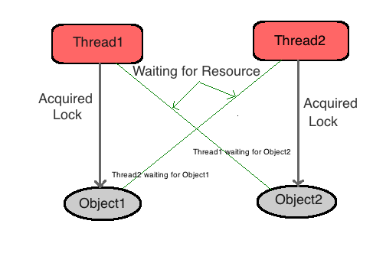
Deadlock in java

Slide 53
Deadlock
A special type of error that you need to avoid that relates specifically to multitasking is deadlock, which occurs when two threads have a circular dependency on a pair of synchronized objects.
For example, suppose one thread enters the monitor on object X and another thread enters the monitor on object Y.
If the thread in X tries to call any synchronized method on Y, it will block as expected.
However, if the thread in Y, in turn, tries to call any synchronized method on X, the thread waits forever, because to access X, it would have to release its own lock on Y so that the first thread could complete

Slide 54
Conclusion
Every thread in Java has a priority that helps the thread scheduler to determine the order in which threads scheduled.
By default, all the threads had the same priority.
Synchronization in java is the capability to control the access of multiple threads to any shared resource.
Synchronization is built around an internal entity known as the lock or monitor.
Every object has an lock associated with it.

